Slide 1
Loops
(Week 4)
Name: Sheikh Thanbir Alam
Deg: Senior Software Programmer
Org: Army War Game Center, BD Army

Slide 2
Suggested IDE for C#
Visual Studio (Desktop/Laptop→Click to download)
Try Dot Net (Web→Click to view)
Dot Net Fiddle (Web→Click to view)

Slide 3


Loop

Slide 4
Loops in Programming
Why we need loop in programming?
Types of Loop:
For
Foreach
While
Do-While

Slide 5
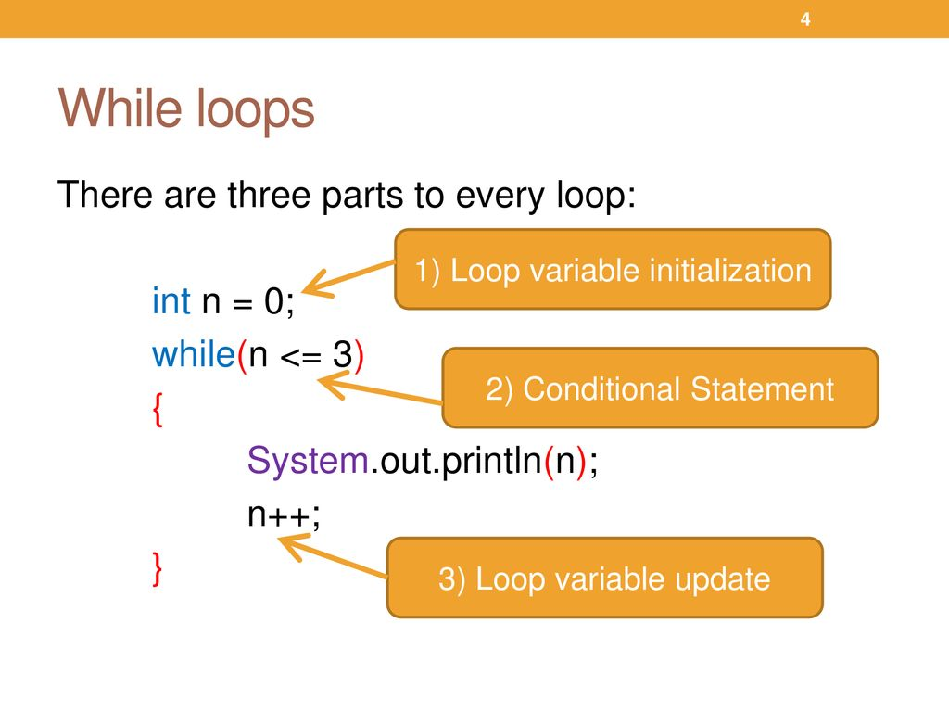

Slide 6
Practice
Print your name 5 times with while loop.
Print your friends name 9 times with while loop.
Print 1 - 20 with while loop. (H.W)

Slide 7
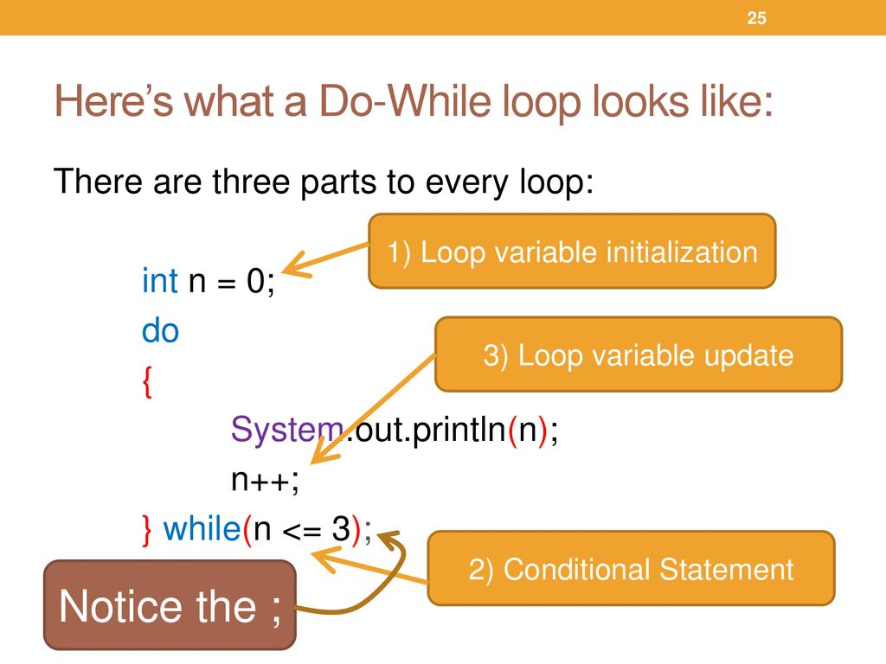

Slide 8
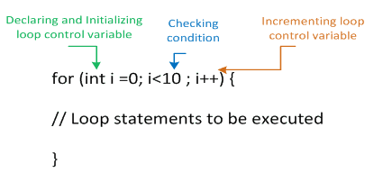
For Loop

Slide 9
Practice
Print your name 5 times with for loop.
Print your friends name 9 times with for loop.
Print 1 - 20 with for loop. (H.W)

Slide 10

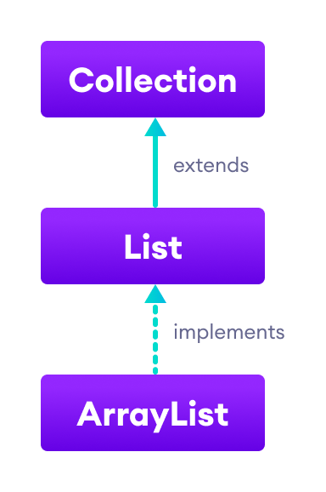
For Each Loop

Slide 11


